Slide 1


Beyond Moravec's Paradox:
A Data-Driven Analysis of AI's Transformative Impact Across Industries
A final project prepared for:
ADSP 32018 IP01 (Autumn 2024) Natural Language Processing and Cognitive Computing
Qi Zhao, zhaoq@uchicago.edu
Dec 12, 2024

Slide 2
Content
Executive Summary
Actionable Recommendations
Article Clean-up and Filtering
Sentiment Analysis
Topic Detection and Sentiment Analysis
Entity Identification and Sentiment Analysis

Slide 3
Executive Summary
Data Processing and Methodology
Initial dataset of ~200,000 articles was systematically cleaned and filtered to 167,763 relevant samples through a three-stage process incorporating linguistic analysis, feature engineering, and topic modeling
Implemented a sophisticated sentiment analysis pipeline, starting with VADER analysis for baseline establishment, followed by data enhancement through manual annotation and BLOOM model labeling, then advanced model fine-tuning with RoBERTa and transformer ensemble architecture, ultimately achieving 82% macro-F1 score through class weight and learning rate optimization.
Enhanced data quality through entity recognition (SpaCy, NER-BERT) and temporal analysis (LDA, BERTopic).
Sentiment Analysis Results
Final sentiment distribution showed balanced coverage: 56.1% neutral (88,344 samples), 42.0% positive (66,060 samples), and 1.9% negative (3,045 samples). This balanced distribution effectively separates genuine AI breakthroughs from general market speculation, ensuring more accurate analysis.
Peak positive sentiment (60%) observed during May-July 2022, indicating significant AI breakthroughs
Positive sentiments strongly associated with technological advancement and market growth
Negative sentiments primarily linked to privacy concerns and data security issues
Note: My initial methodology aimed to combine manual annotation with ChatGPT-3.5 labeling (15,000 samples, $70 investment) for enhanced accuracy. However, due to a Colab system crash after a full day of training, resulting in data loss, which forced me to adapt to use the free BLOOM model for labeling. This limitation presents an opportunity for future improvements.

Slide 4
Executive Summary
Industry and Technology Impact
Finance, healthcare, and media sectors demonstrate highest AI automation potential while facing rigorous scrutiny
Computer Vision dominates positive coverage (40-70%), while Natural Language Processing shows increasing negative sentiment trends
Major cloud providers (Vertex AI, Azure AI, Google Cloud AI) lead both positive and negative coverage
Executive positions (CTO, CEO) show increasing AI impact compared to operational roles
Regional and Organizational Trends
Developed countries, particularly European nations, lead AI discussions and implementation
Tech giants (Microsoft, Google) dominate positive coverage while facing increased scrutiny over AI monopoly concerns
Regulatory bodies, especially in the EU, emerge prominently in negative coverage, indicating growing oversight focus

Slide 5
Actionable Recommendations
Despite the widespread AI enthusiasm revealed in our analysis, we observe a significant AI bubble where organizations rush towards adoption without adequate preparation. While AI advancement is inevitable and necessary for future competitiveness, our analysis shows varying degrees of implementation readiness across industries, alongside persistent technical and ethical challenges. This complex landscape demands thoughtful, stakeholder-specific approaches:
Strengthen regulatory frameworks around AI deployment, especially in sensitive sectors
Develop balanced policies that encourage innovation while protecting privacy and labor rights
Establish clear guidelines for AI adoption in public sectors, particularly in EU markets
Support AI education and workforce transition programs
For Government Bodies
Focus on developing AI-complementary skills rather than competing with AI
Stay informed about AI developments in relevant industry sectors
Prepare for potential role transitions through continuous learning
Understand both opportunities and limitations of AI in specific professional contexts
For Individuals

Slide 6
Actionable Recommendations
For Organizations
Focus on developing reliable Computer Vision applications where public acceptance is higher
Enhance privacy and security measures in Natural Language Processing implementations
Maintain transparency in AI development to build public trust
Finance, healthcare, and media sectors should prioritize gradual AI integration while addressing sector-specific concerns
Smaller organizations should start with proven AI solutions rather than cutting-edge applications
Develop comprehensive employee training programs before implementing AI automation
European companies should focus on compliance with strict EU regulations
Developing market organizations should prioritize basic AI infrastructure development
Global companies need region-specific AI implementation strategies
Tech Companies
Traditional Industries
Regional Considerations

Slide 7
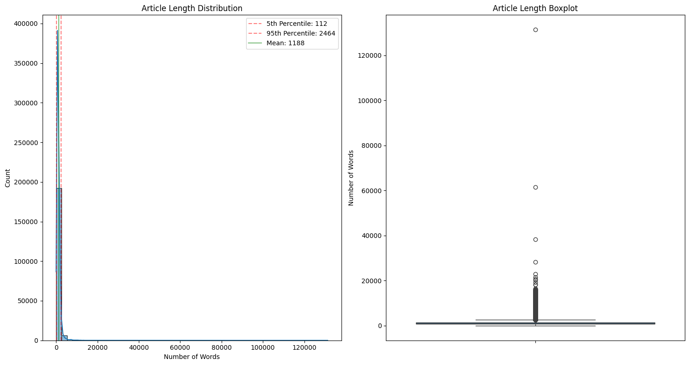
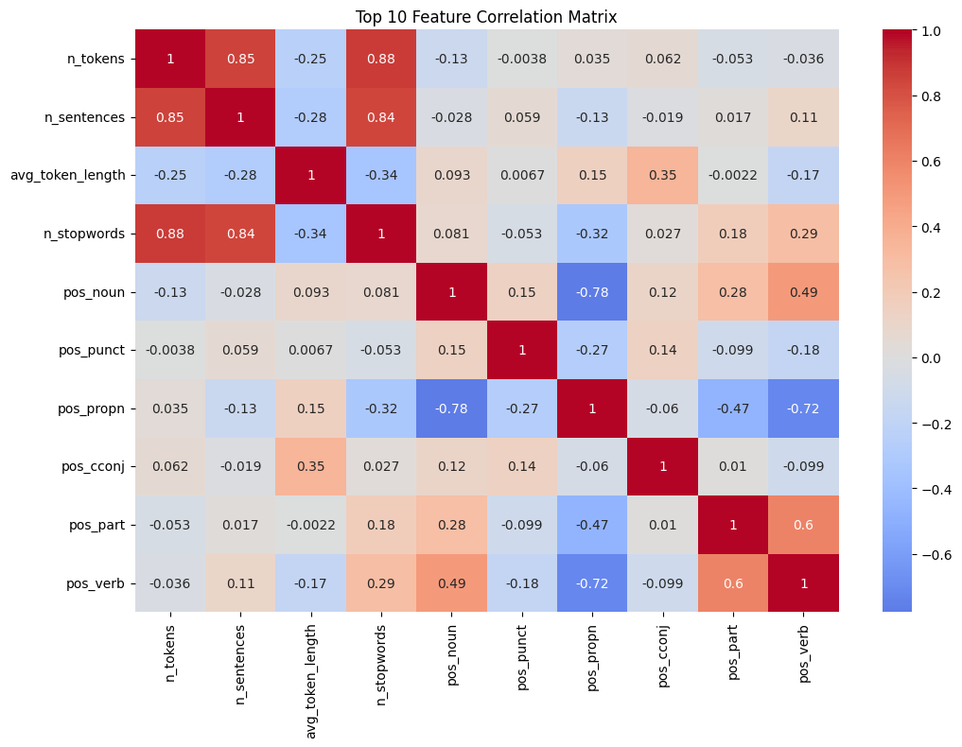
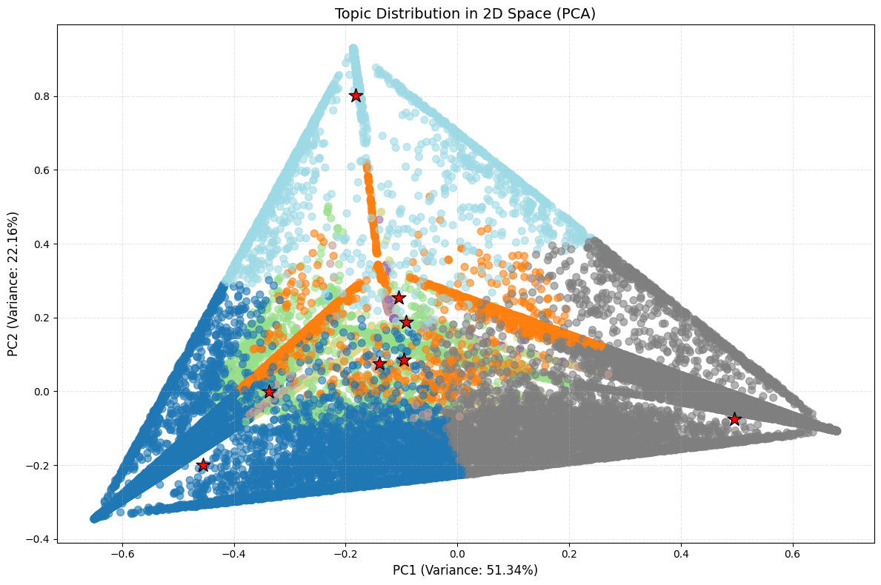
Article Clean-up and Filtering
To ensure the data quality while focusing on business and technology relevant content for efficient analysis, I apply a three-step systemic approach:
Step 1: Initial Data Cleaning (180,564 samples left)
Cleaned various web elements and formatting residuals
Removed irrelevant artifacts (URLs, emails, non-ASCII characters)
Applied length-based filtering to remove outliers
Retained 180,564 articles after initial cleaning
Step 2: Feature Extraction and Engineering
Performed linguistic analysis:
Basic text metrics (length, sentence structure)
Grammatical analysis (parts of speech)
Entity recognition (companies, products, locations)
Created composite features for:
Technology density, Business relevance, Industry impact
Applied domain-specific weighting system
Step 3: Topic Modeling and Refinement (167,763 samples left)
Conducted topic analysis for major themes
Evaluated and optimized topic count
Selected 8 distinct topics
Applied 0.55 probability threshold and 90% retention rate
Topic distribution after refinement: Topic 0 -11.1%, Topic 1-6.8%; Topic 2 -15.3%; Topic 3 - 20.6%; Topic 4 - 0.3%; Topic 5 - 18.3%; Topic 6 - 7.6%; Topic 7 - 20.1%

Slide 8
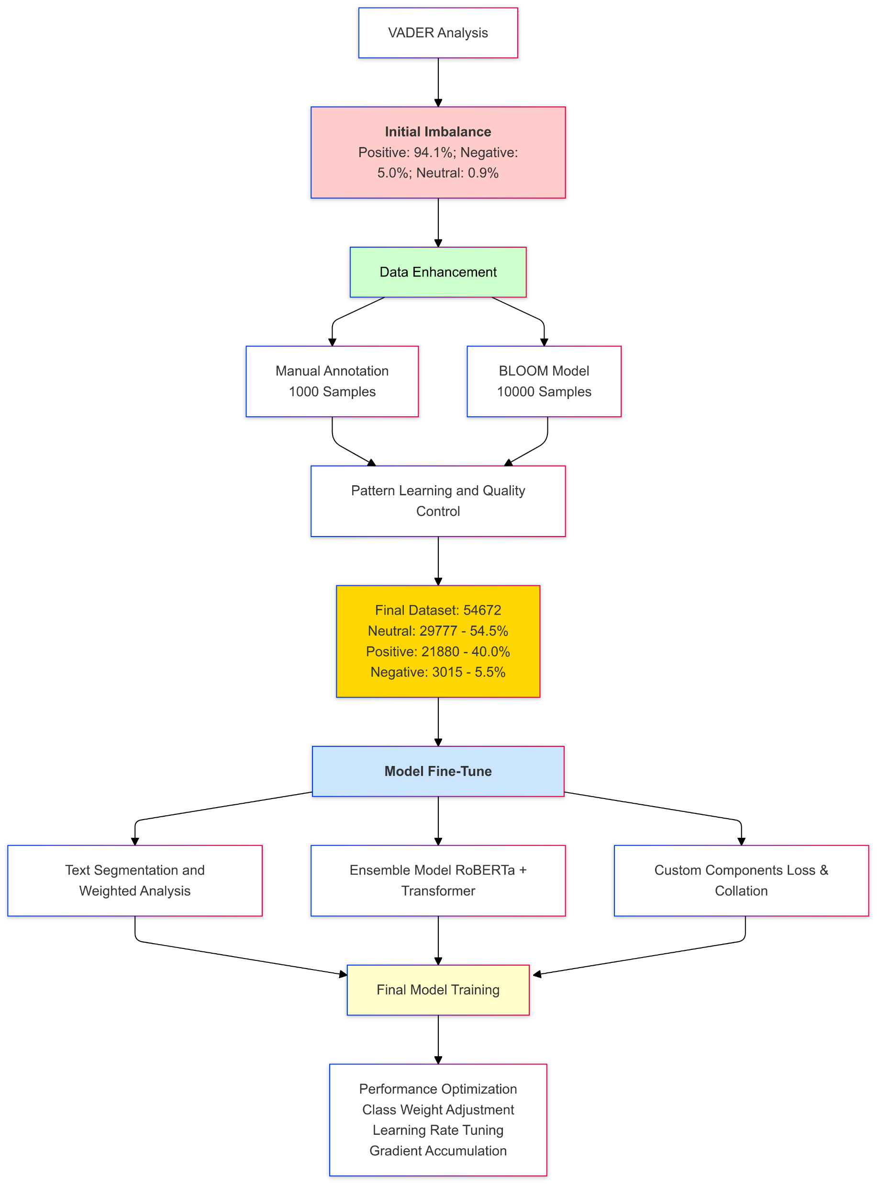
Sentiment Analysis
To identify the top reasons for successful data science/AI initiatives, I predicted article sentiments using a multi-stage analysis approach.
Initial VADER analysis revealed significant class imbalance (94.1% positive, 5.0% negative, 0.9% neutral), indicating potential classification bias and necessitating a more sophisticated method.
I developed a comprehensive framework combining manual annotation (1,000 samples), BLOOM model for semi-supervised learning (10,000 samples), and an ensemble architecture integrating RoBERTa with custom optimization techniques (as shown in the right plot). This approach successfully balanced the dataset and achieved 82% macro-F1 score across all sentiment categories.
Note: My annotation framework differentiates between actual AI progress, general industry updates, and critical concerns.
Positive: Verified AI breakthroughs and technical achievements with proven results
Neutral: General AI industry discussions and market outlooks
Negative: Critical reports on AI risks, failures, and safety concerns

Slide 9
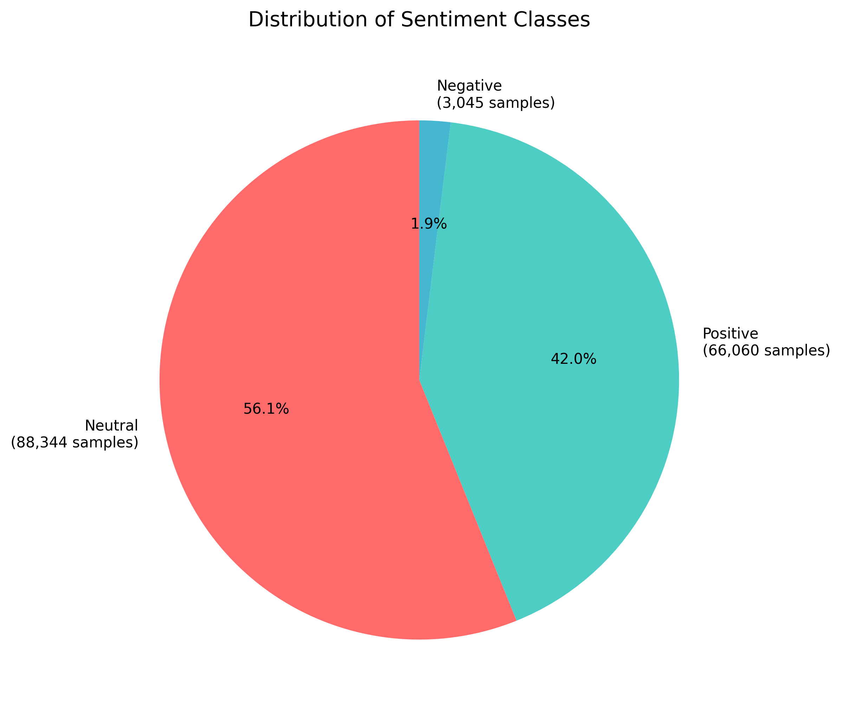
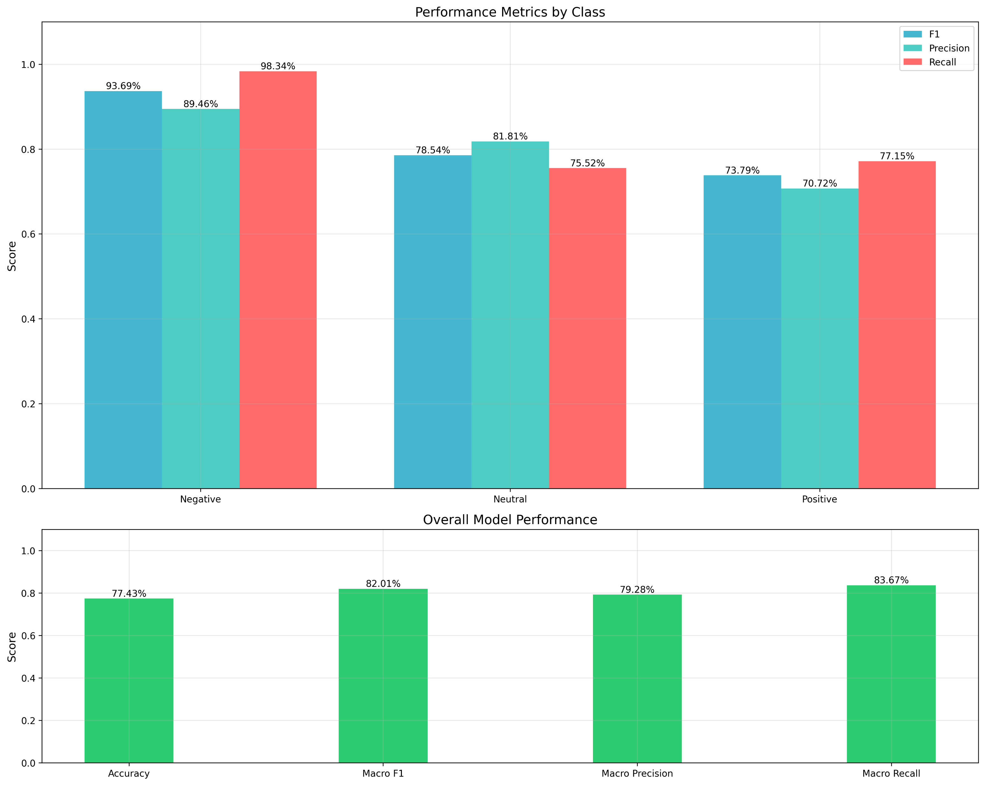
Sentiment Analysis
My predictive model achieved relatively strong overall performance metrics, with 77.43% accuracy and 82.01% macro-F1 score, showing particularly impressive results for negative sentiment detection (93.69% precision, 98.34% recall).
After applying the model to the entire dataset, 56.1% were classified as neutral (88,344 samples), 42.0% were classified as positive (66,060 samples), and 1.9% were classified as negative (3,045 samples).
This balanced approach successfully overcame typical sentiment analysis challenges, maintaining consistent performance across all sentiment categories (70-98% range) while effectively handling class imbalance, making it a reliable tool for analyzing AI initiative success factors.

Slide 10
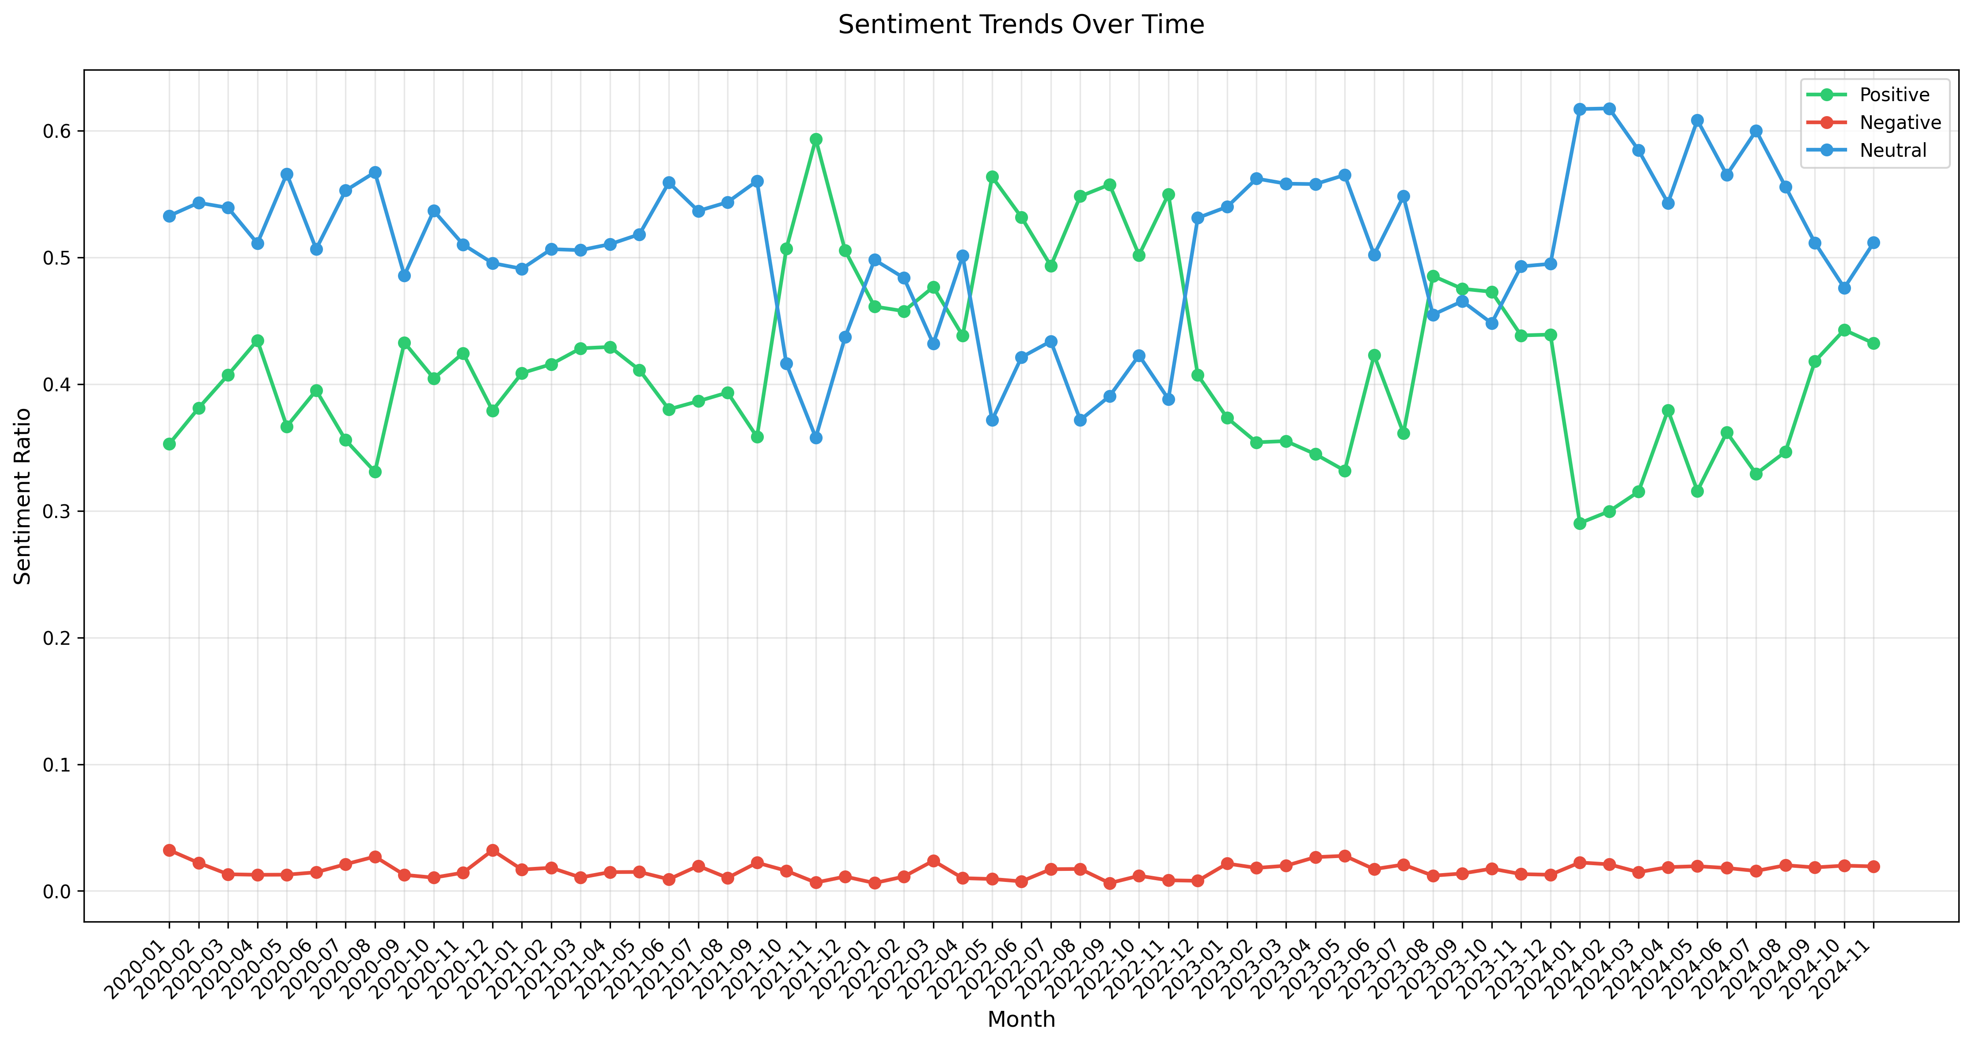
Sentiment Analysis Over Time
The sentiment analysis reveals that AI development maintains predominantly positive and neutral coverage, collectively accounting for over 95% of discussions.
Based on our focus on distinguishing genuine technical achievements from general updates, significant AI breakthroughs were identified during 2022-05 to 2022-07, where positive sentiment peaked at nearly 60%. While neutral coverage has fluctuated between 40-60%, negative sentiment has remained consistently low (around 2%), indicating persistent but stable levels of concern about AI development.

Slide 11
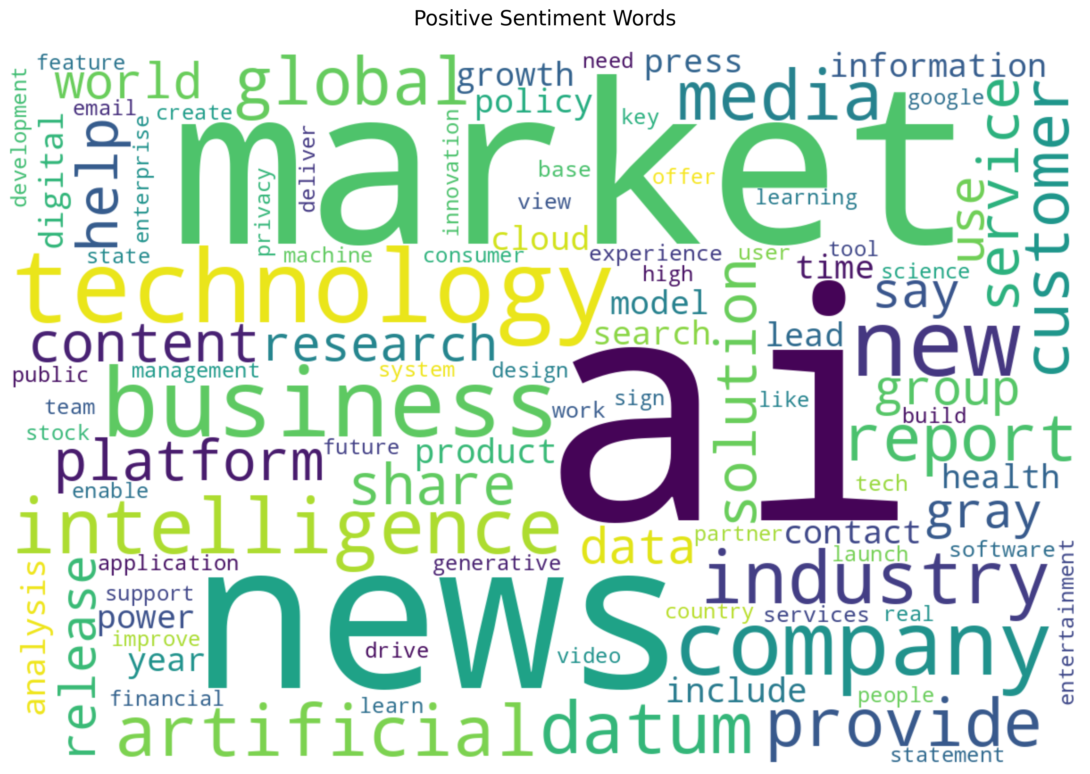
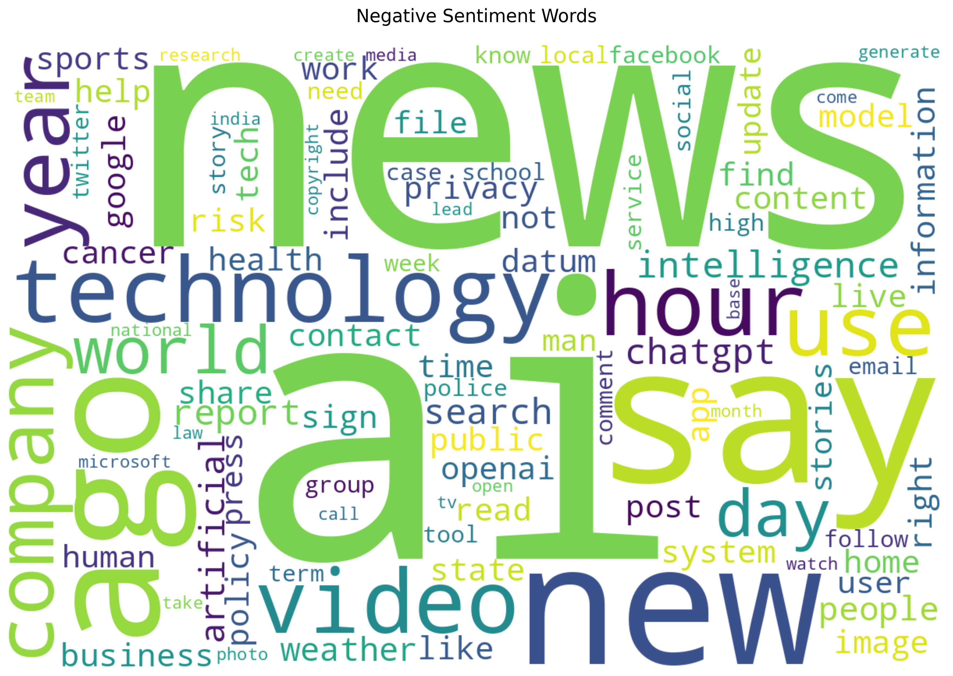
Sentiment Analysis with Keyword Pattern
The word cloud analysis clearly reveals distinct patterns between sentiment categories.
In the Positive word cloud, prominent terms included "technology", "market", "business", "artificial", "intelligence", and "company", while the Negative word cloud highlighted terms such as "news", "technology", "say", "video", "privacy", and "data".
Associated with Positive Sentiment
Associated with Negative Sentiment

Slide 12
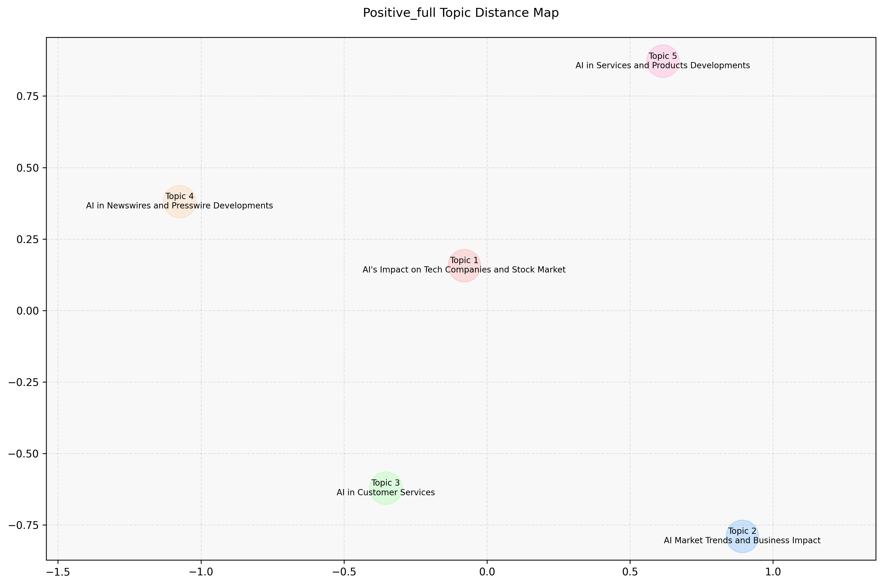
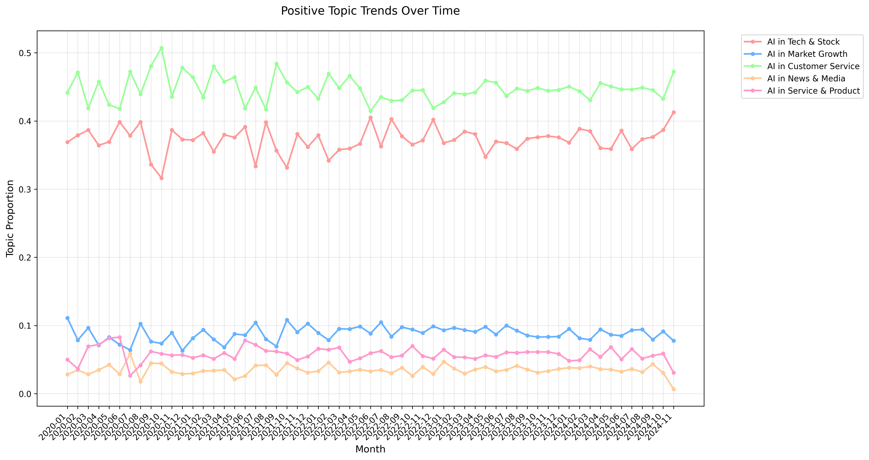
Topic Detection: Positive Sentiment
Based on LDA
Top 5 Positive Topics:
Topic 1: AI's Impact on Tech Companies and Stock Market
Topic 2: AI Market Trends and Business Impact
Topic 3: AI in Customer Services
Topic 4: AI in Newswires and Presswire Developments
Topic 5: AI in Services and Products Developments
Analyzing the temporal trends, AI in Customer Service and Tech & Stock Market consistently dominated positive coverage (40-50% and 35-40% respectively), while other topics including Market Growth, News & Media, and Service & Product developments maintained stable but lower proportions (5-10% each) throughout the period.

Slide 13
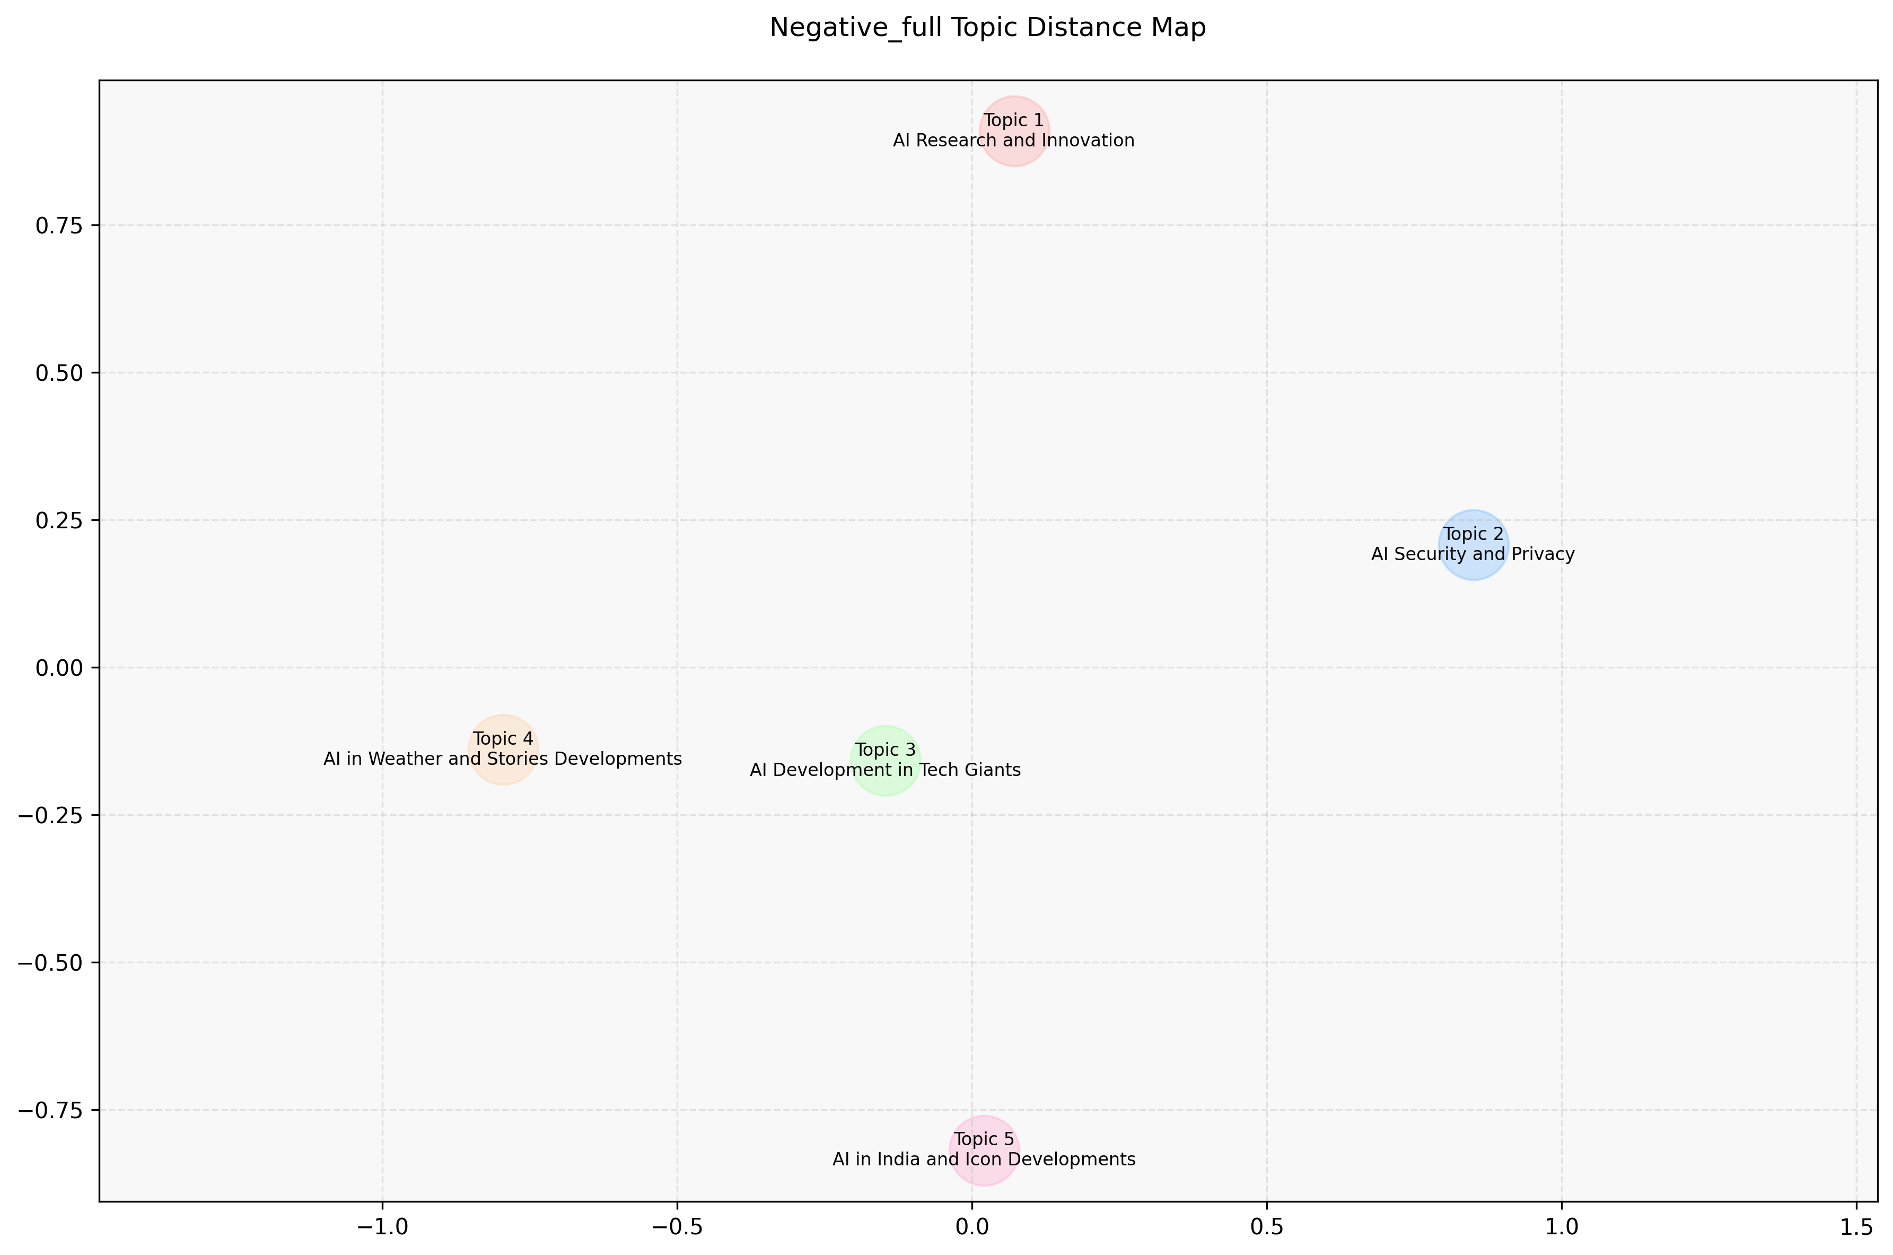
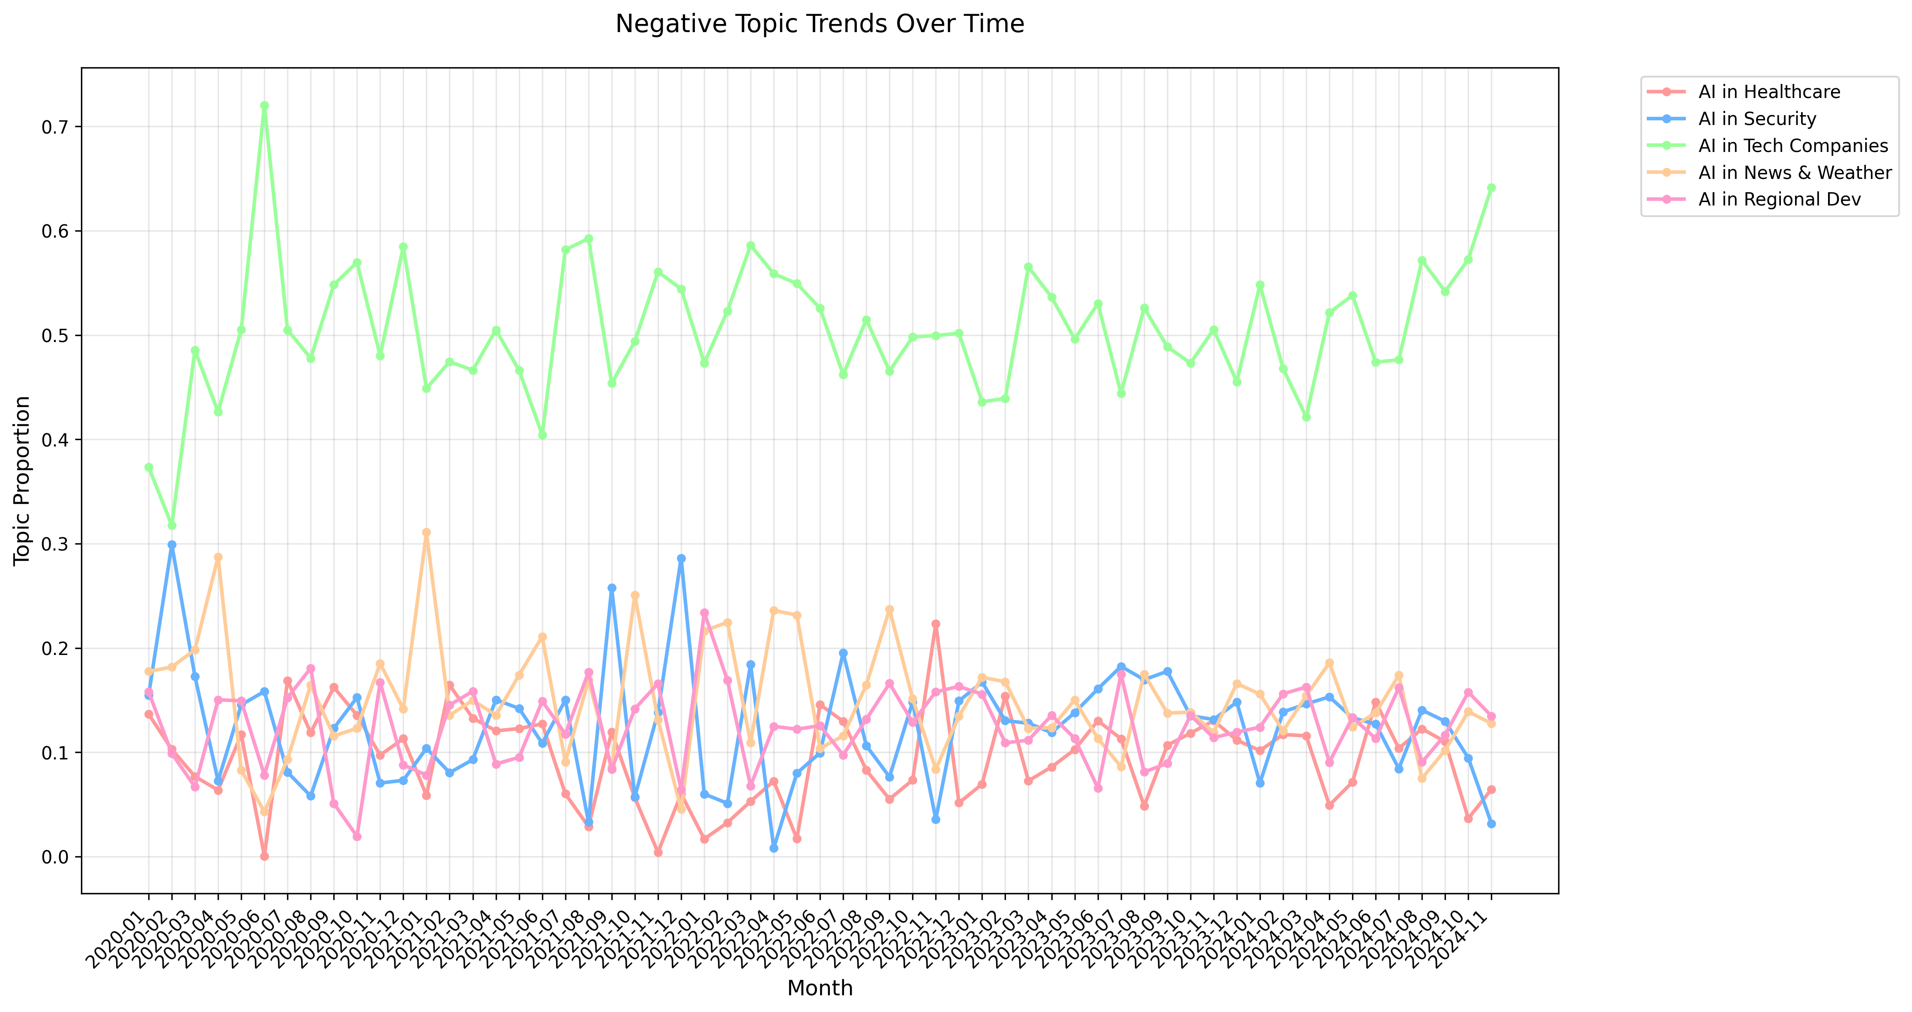
Topic Detection: Negative Sentiment
Based on LDA
Top 5 Negative Topics:
Topic 1: AI Research and Innovation
Topic 2: AI Security and Privacy
Topic 3: AI Development in Tech Giants
Topic 4: AI in Weather and Stories Developments
Topic 5: AI in India and Icon Developments
Negative coverage was dominated by concerns about tech giants' AI monopoly (40-65%), with a recent sharp increase to 65%, while other issues like security, healthcare, and regional development maintained stable but lower proportions (10-20%). This trend indicates growing anxiety about AI industry concentration.

Slide 14
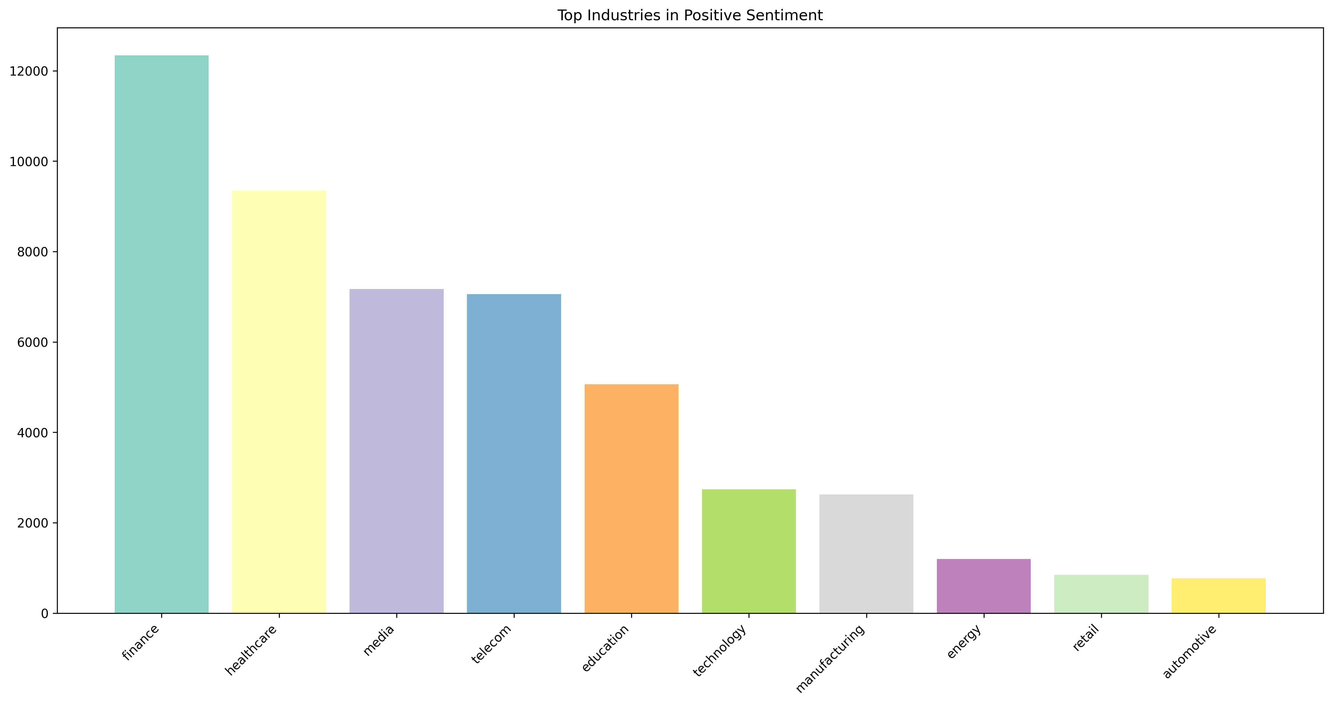
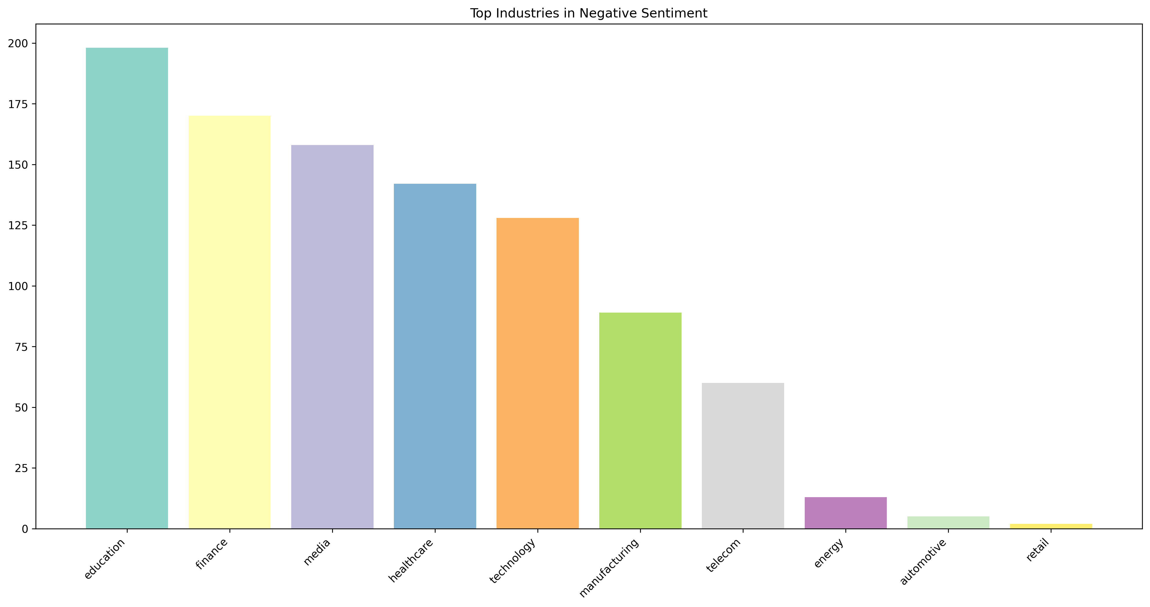
Entity Analysis: Industry Trends
NER with spaCy
Our entity analysis reveals a compelling pattern in AI automation across industries, highlighting the complex relationship between technological adoption and associated concerns.
For positive sentiment, leading sectors like finance, healthcare, and media demonstrate tangible automation achievements, such as automated financial analytics, AI-driven medical diagnostics, and automated content generation.
Similar sectors also show significant concerns about automation risks and ethical considerations, such as algorithmic trading risks in finance, automated diagnosis reliability in healthcare, and AI-generated content authenticity in media, reflecting how industries at the forefront of automation face the most rigorous scrutiny.

Slide 15
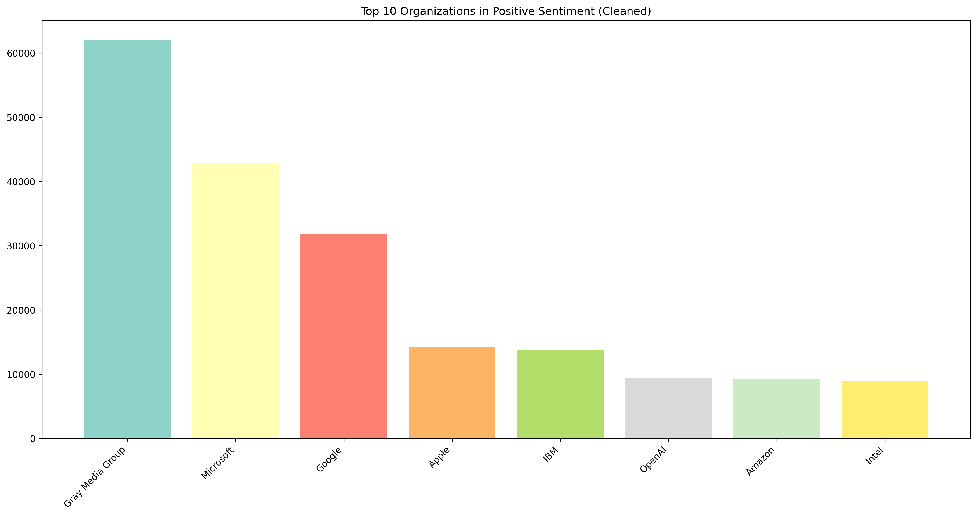
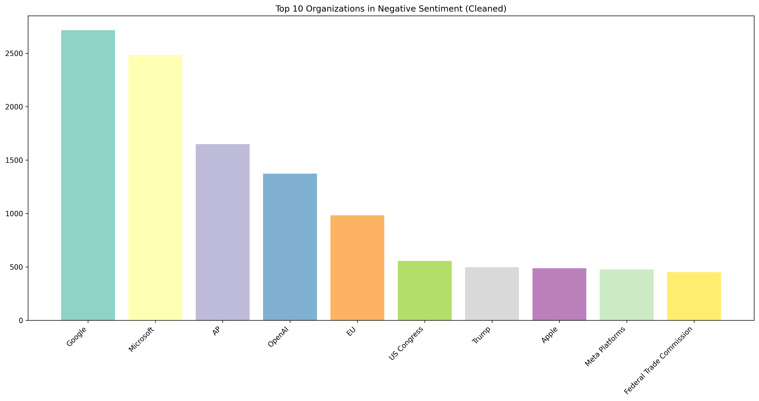
Entity Analysis: Organization Trend
NER with spaCy
Our entity analysis reveals distinct patterns in organizational AI coverage. Leading tech and media companies (Gray Media Group, Microsoft, Google) dominate positive coverage with their AI innovations and implementations.
In negative coverage, while tech giants remain prominent, regulatory bodies (EU) and oversight organizations emerge frequently, reflecting growing tensions between AI advancement and regulatory oversight.

Slide 16
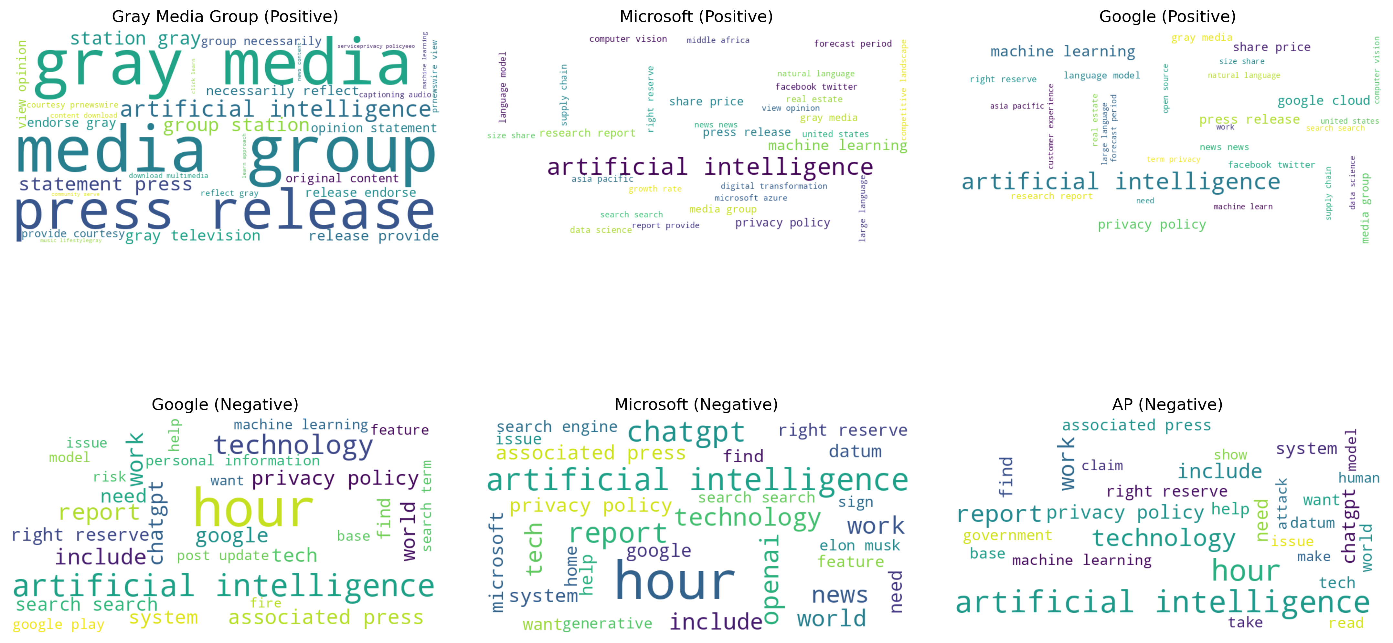
Entity Analysis: Organization Trend
NER with spaCy
In positive mentions, organizations' word clouds emphasize business innovations and technological achievements, featuring terms like "machine learning", "digital transformation", and "press release".
The negative coverage word clouds reveal a focus on regulatory concerns, with prominent terms like "privacy policy", "personal information", and "government" across major tech companies.

Slide 17
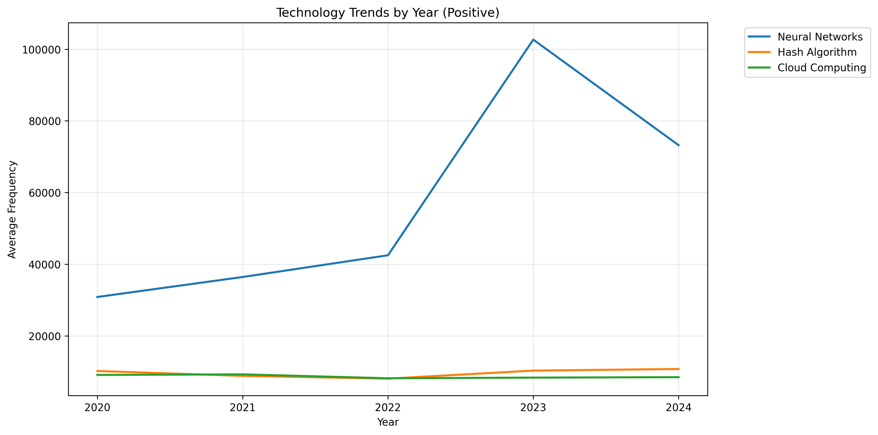
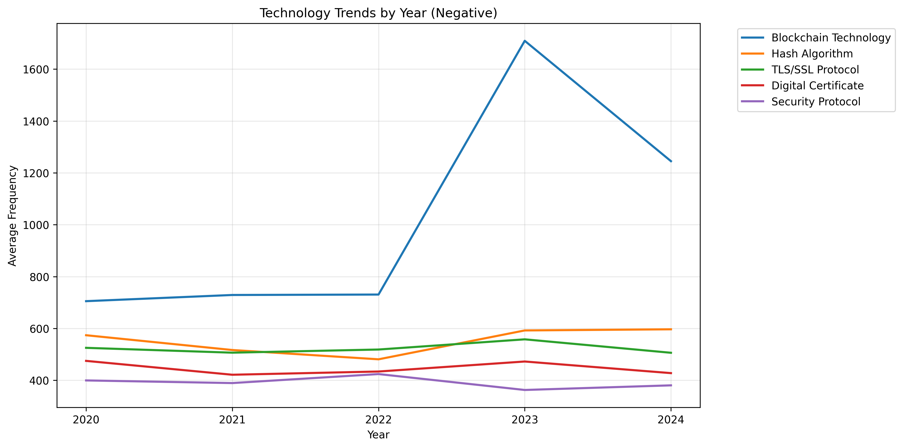
Entity Analysis: Technology Trends
NER with spaCy
Technology analysis reveals a distinct pattern of positive sentiment toward AI advancement contrasting with persistent privacy and security concerns in the digital era.
In positive coverage, Neural Networks significantly dominate the technological landscape, showing dramatic growth particularly from 2022 to 2023 (reaching ~100,000 frequency), while traditional technologies maintain stable lower frequencies.
For negative coverage, security and privacy-focused technologies (Blockchain, TLS/SSL Protocol, Digital Certificate, Security Protocol) consistently appear in critical discussions, reflecting growing public and industry concerns about the security implications of rapid AI advancement.

Slide 18
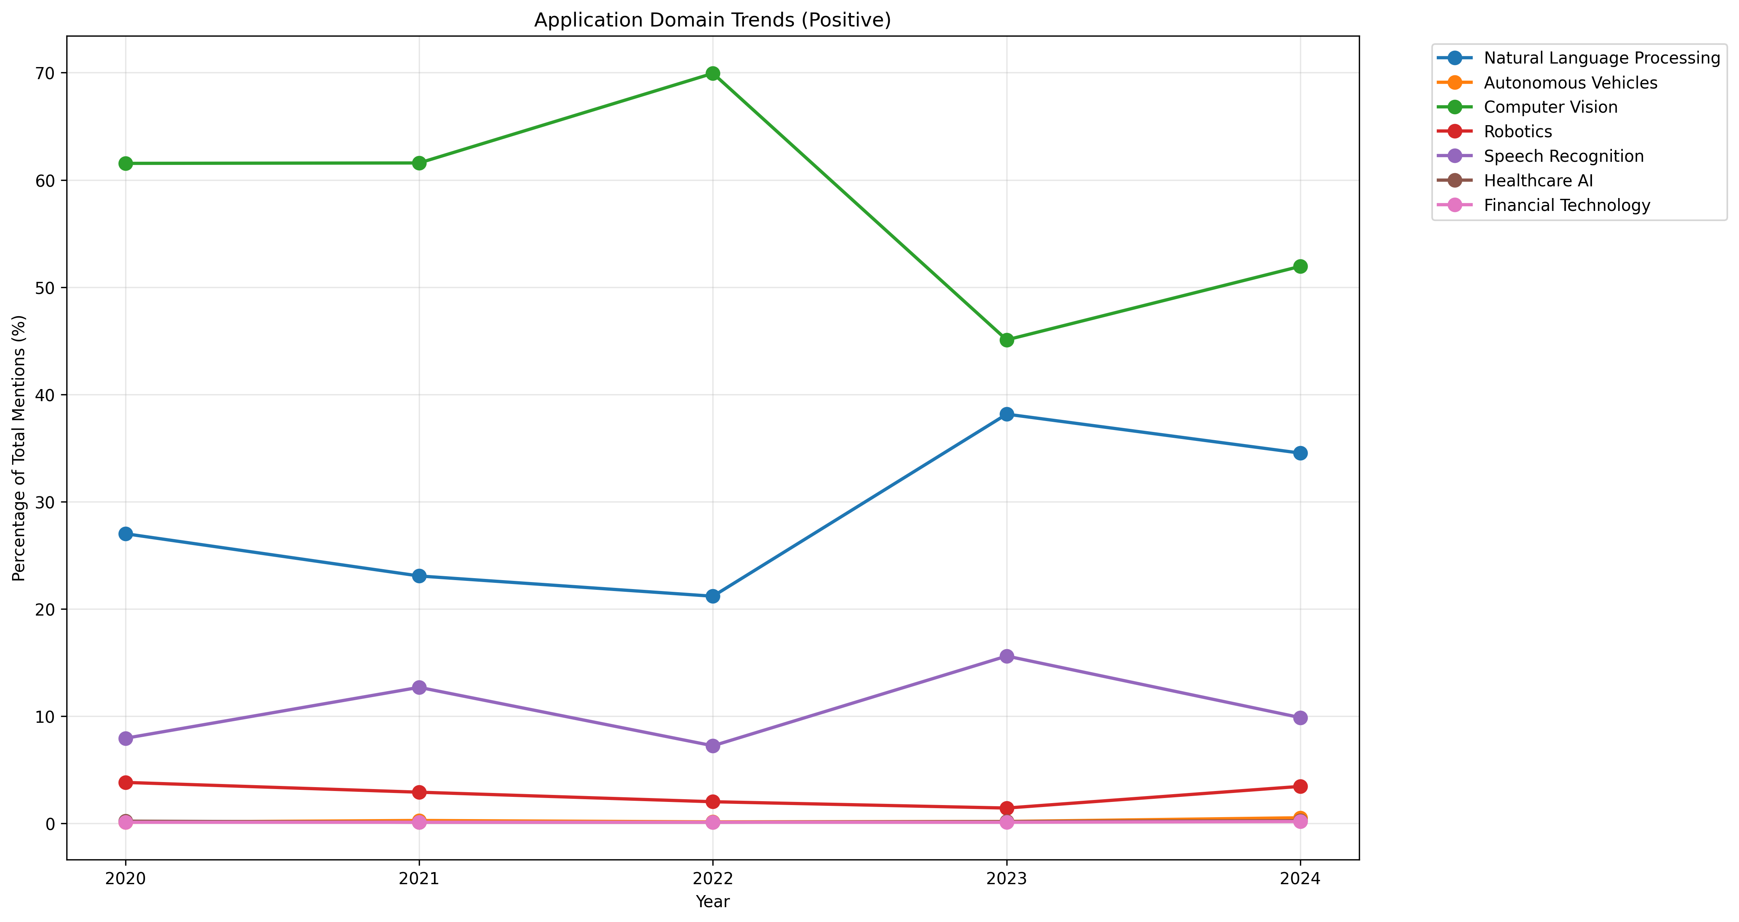
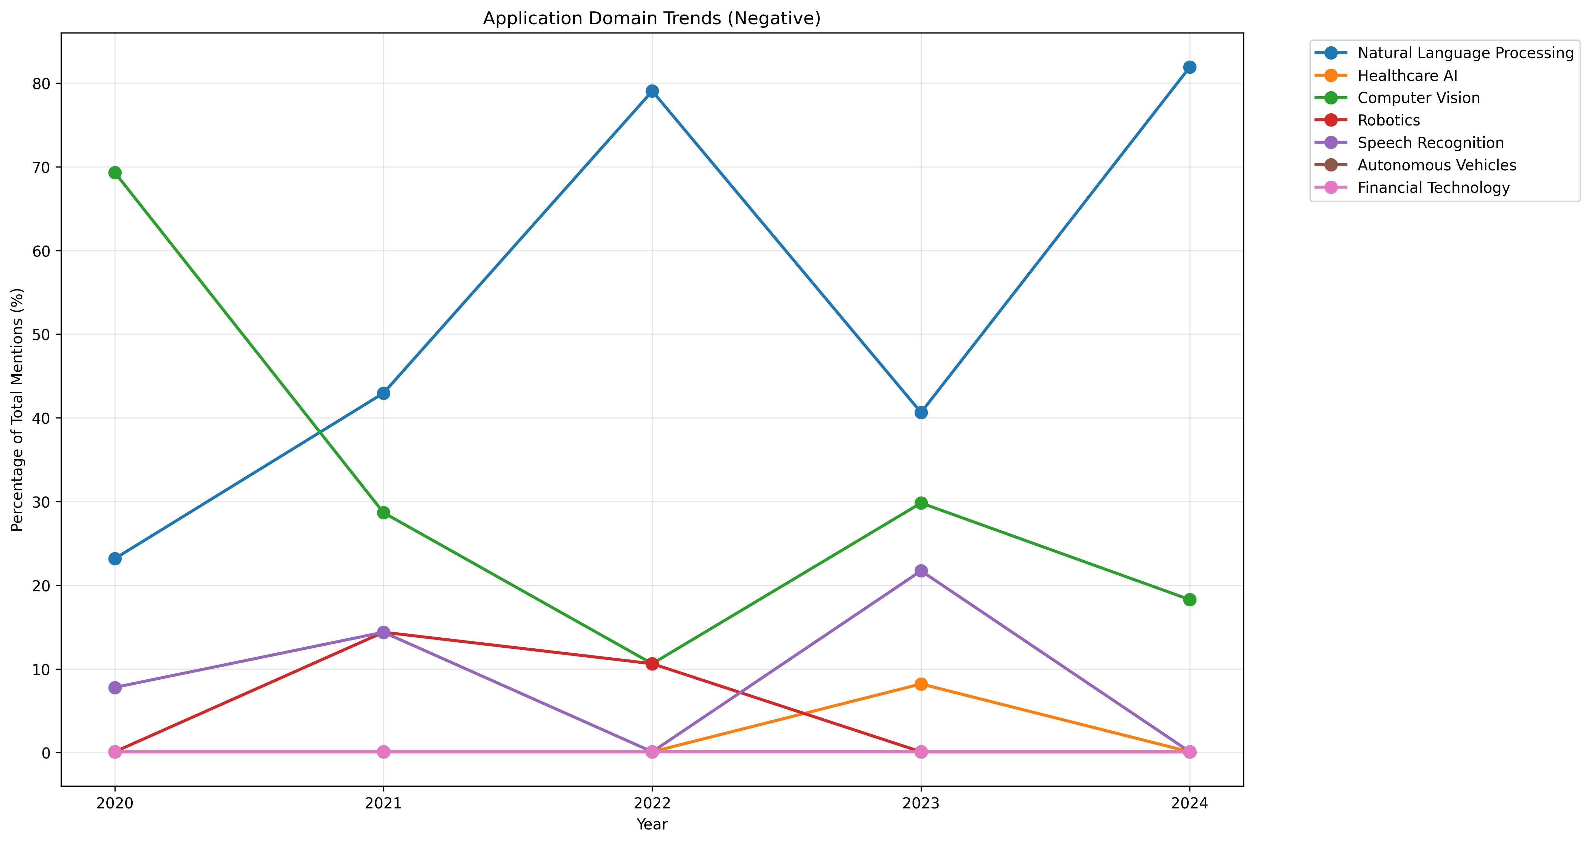
Entity Analysis: Application Trends
NER with spaCy
Application domain analysis reveals contrasting trends, with Computer Vision dominating positive coverage while Natural Language Processing leads negative discussions.
In positive coverage, Computer Vision leads consistently (40-70%), followed by Natural Language Processing showing steady growth, while other applications like Healthcare AI and Financial Technology maintain lower but stable presence.
In negative coverage, Natural Language Processing shows dramatic increase (20% to 80%) while Computer Vision's negative mentions decline significantly (from 70% to 20%), suggesting growing public concerns about language AI applications while computer vision gains wider acceptance.

Slide 19
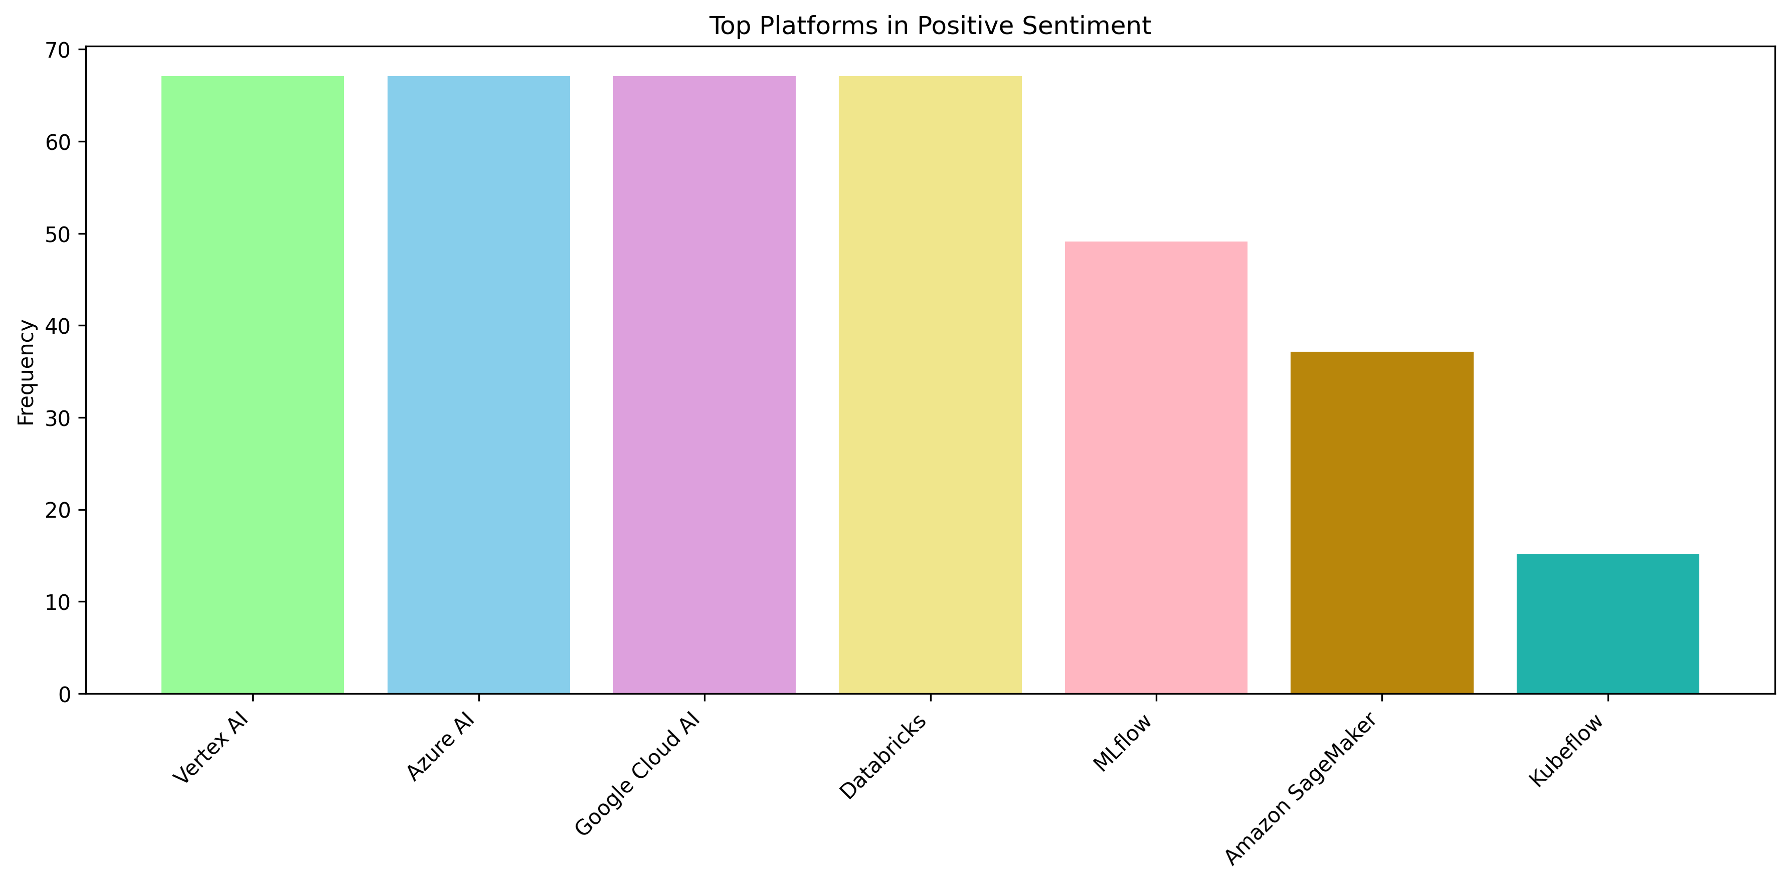
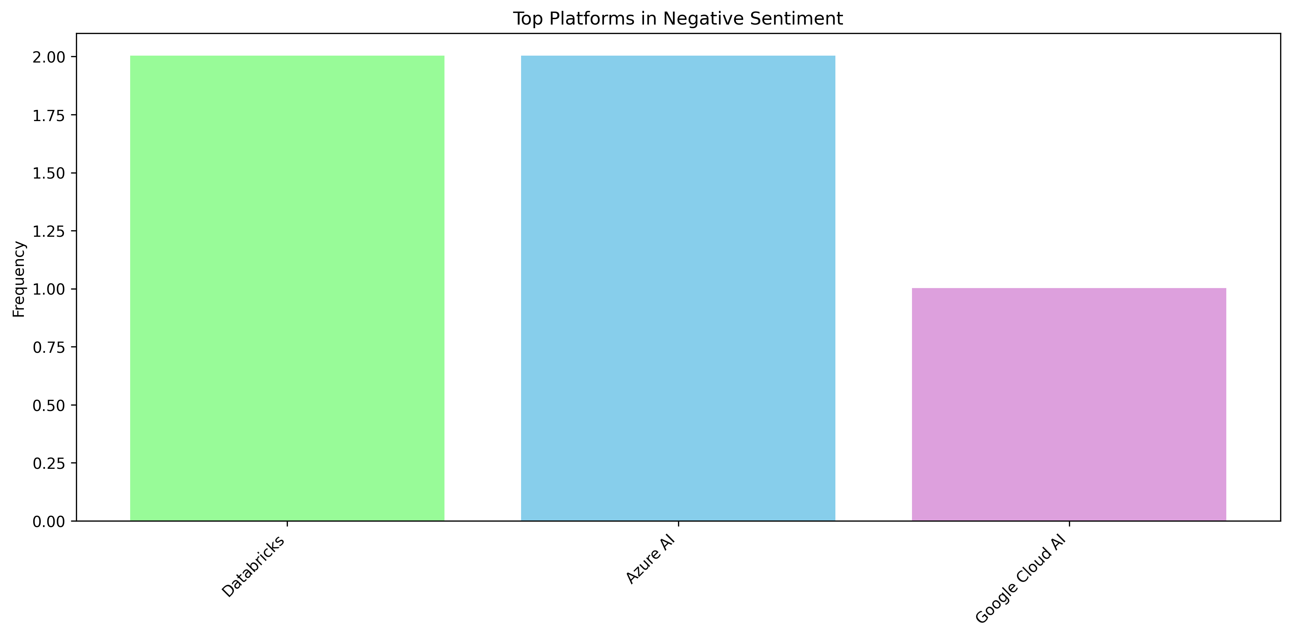
Entity Analysis: Platform Trends
NER with spaCy
Platform analysis reveals a concentrated distribution of sentiment, with major cloud providers dominating both positive and negative coverage in AI discussions.
In positive coverage, leading platforms (Vertex AI, Azure AI, Google Cloud AI, Databricks) show similar high frequencies (~65-70), while smaller platforms have notably lower presence.
In negative coverage, enterprise platforms (Databricks, Azure AI, Google Cloud AI) receive the most criticism, suggesting heightened scrutiny of major commercial AI deployments.

Slide 20
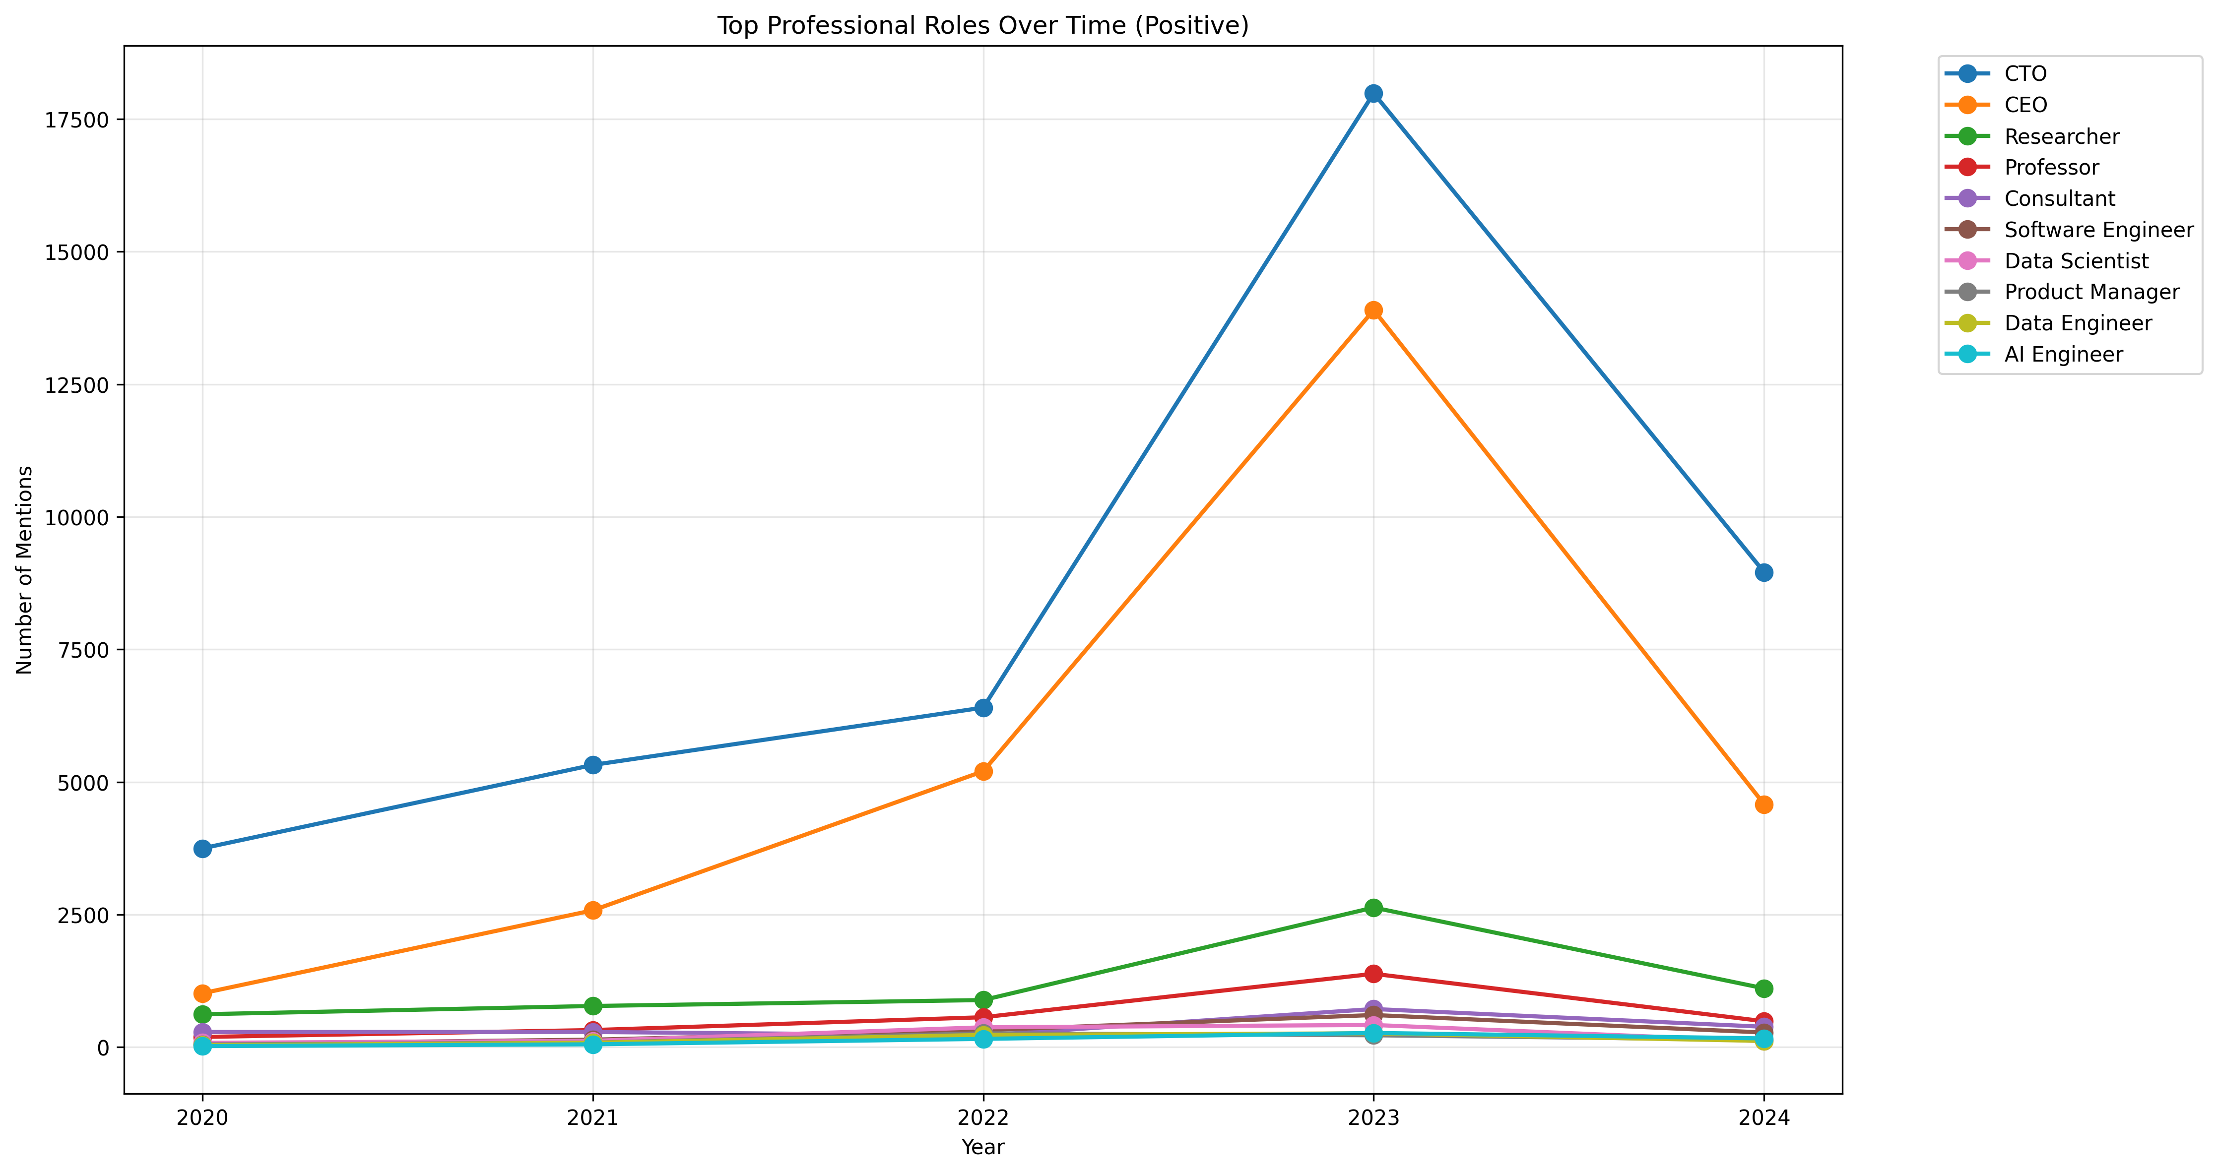
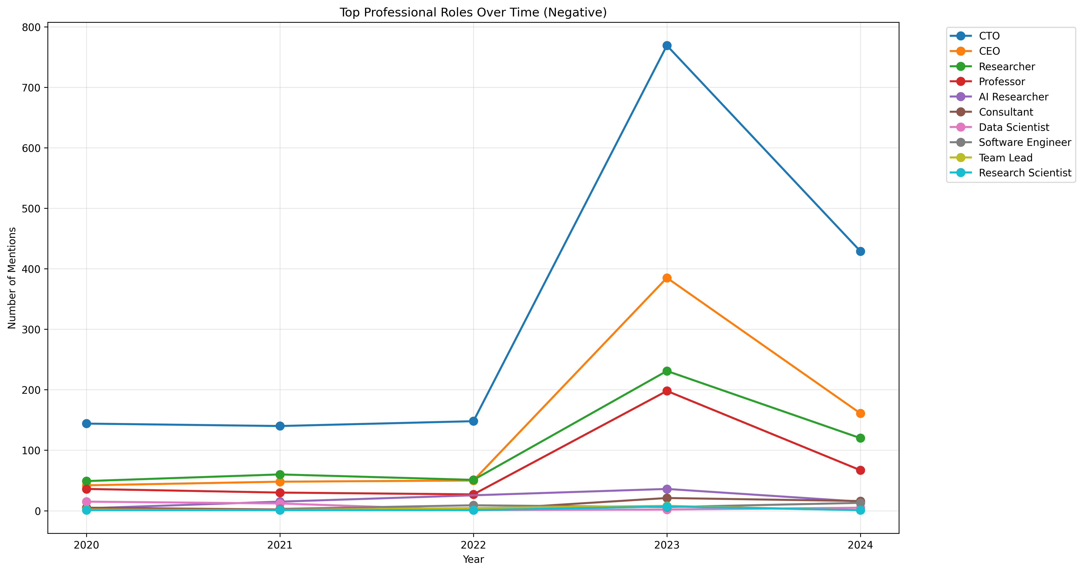
Entity Analysis: Profession Trends
NER with spaCy
Professional role analysis reveals a striking hierarchical pattern in AI discussions, highlighting potential impacts of AI disruption across different organizational levels.
In both positive and negative coverage, executive positions (CTO, CEO) dominate discussions with dramatic growth during 2022-2023, while operational roles (Engineers, Scientists, Consultants) maintain consistently low coverage, suggesting that AI's immediate impact may be more pronounced in technical and middle-management positions rather than executive leadership. This pattern shows a clear stratification in AI's perceived impact on different professional levels.

Slide 21
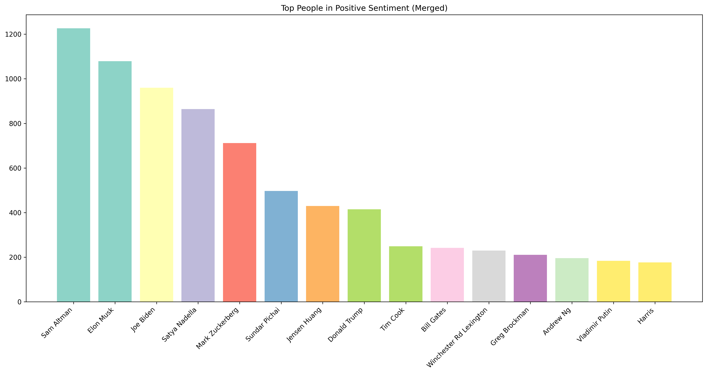
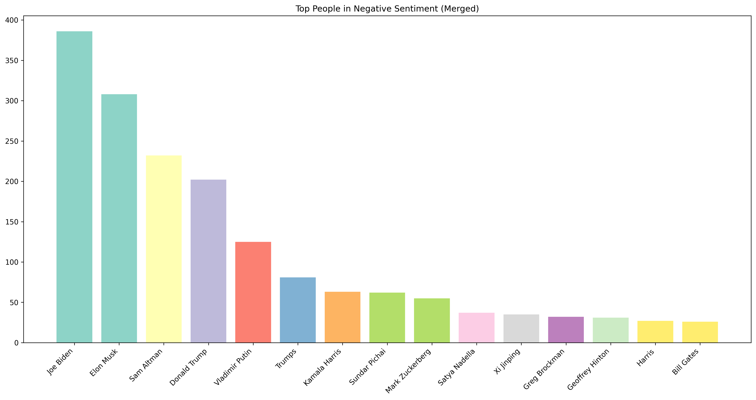
Entity Analysis: People Trends
NER with spaCy
Our entity analysis reveals contrasting coverage patterns for different AI industry figures.
In positive coverage, we see a mix of tech leaders and innovators, with AI company executives (Sam Altman), tech entrepreneurs (Elon Musk), and industry visionaries (Mark Zuckerberg, Bill Gates) receiving recognition for their contributions to AI advancement and strategic vision.
The negative coverage, however, focuses more intensely on a smaller group of key figures (Joe Biden, Elon Musk) and includes more political leaders, suggesting heightened concerns about AI regulation and governance. This pattern reflects the growing intersection of AI development with political and regulatory discussions.

Slide 22
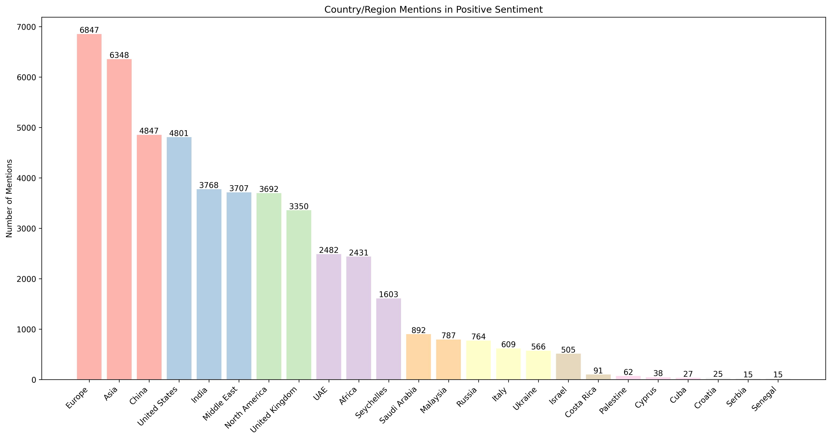
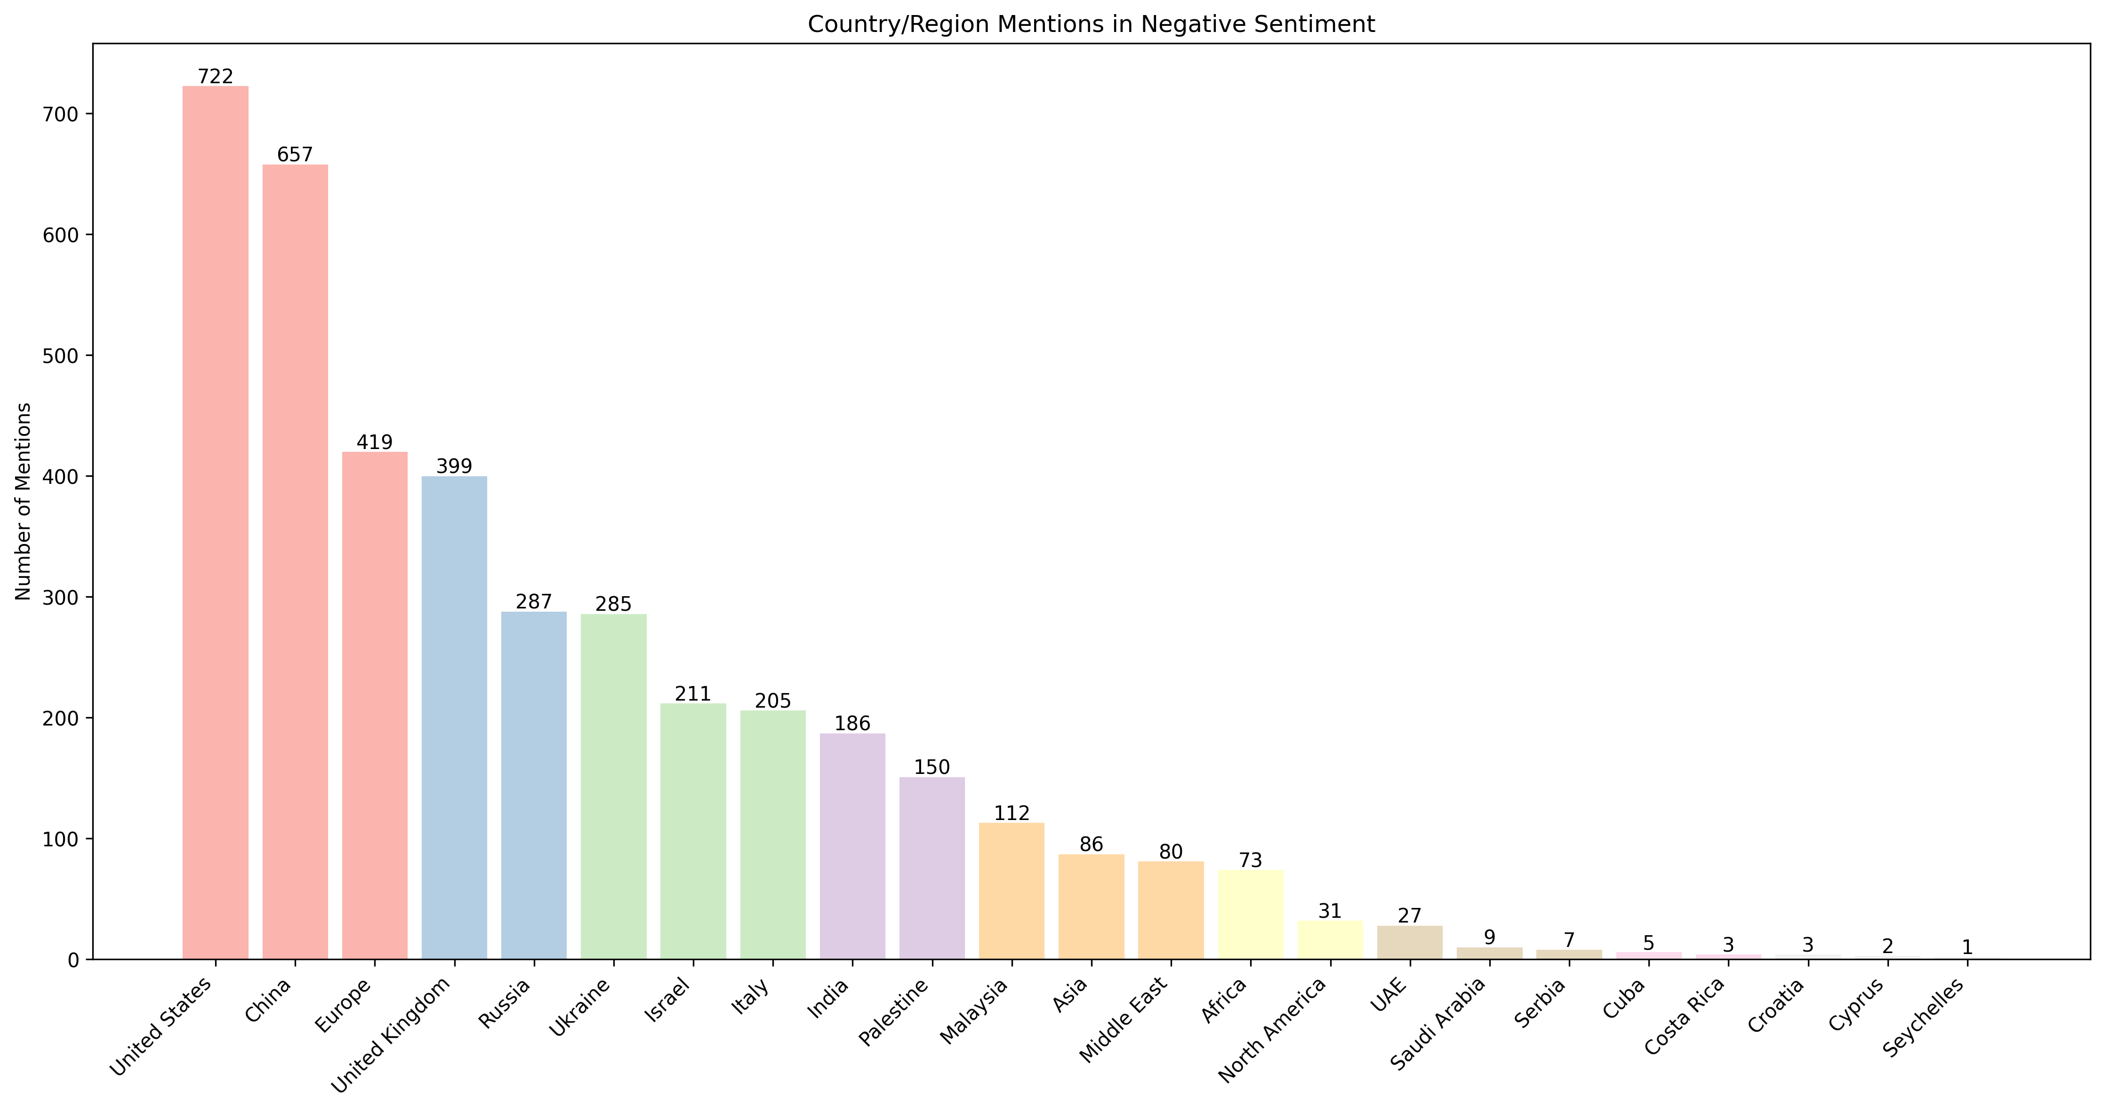
Entity Analysis: Location Trends
NER with spaCy
In general, developed countries/regions drive most of the AI discussion compared to developing regions
Europe leads in positive mentions, particularly France, Spain, Italy, Germany and the UK, each exceeding 3,000
Other countries with notable positive mentions: Japan, South Korea, Brazil, Argentina
Middle East (Saudi Arabia, UAE) has fewer positive mentions, below 1,000
Africa and Southeast Asia generally have the lowest volumes

Slide 23
Thank You
Thank you Professor Ignas Grabauskas and TA Peter Pezon for your invaluable guidance and patience throughout this course.
Thank you my dear classmates for your kindness in sharing this journey of discovery.
This journey has been incredibly enriching, and excellence remains my goal.
Qi Zhao
Dec 12, 2024
See you in the future! 后会有期！

